Slide 1
Outliers Detection Using Interquartile Range (IQR) Method:
Presented by:
Sunitha Mekala

Slide 2
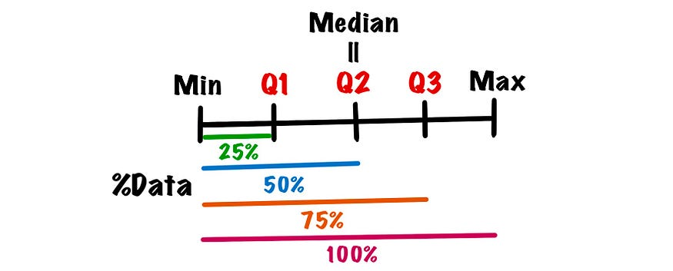
Inter Quartile Range (IQR):
One common technique to detect outliers is using IQR (interquartile range).
In specific, IQR is the middle 50% of data, which is Q3-Q1.
Q1 is the first quartile, Q3 is the third quartile and quartile divides an ordered dataset into 4 equal-sized groups.

Slide 3
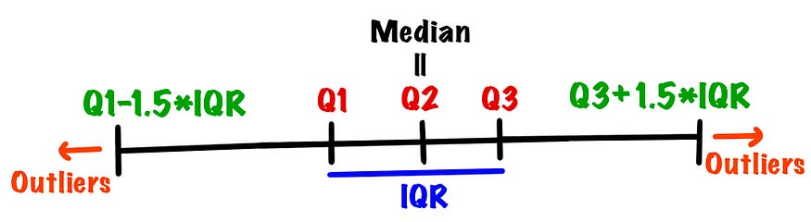
The interquartile range method defines outliers as values larger than Q3 + 1.5 * IQR or the values smaller than Q1 – 1.5 * IQR.

Slide 4
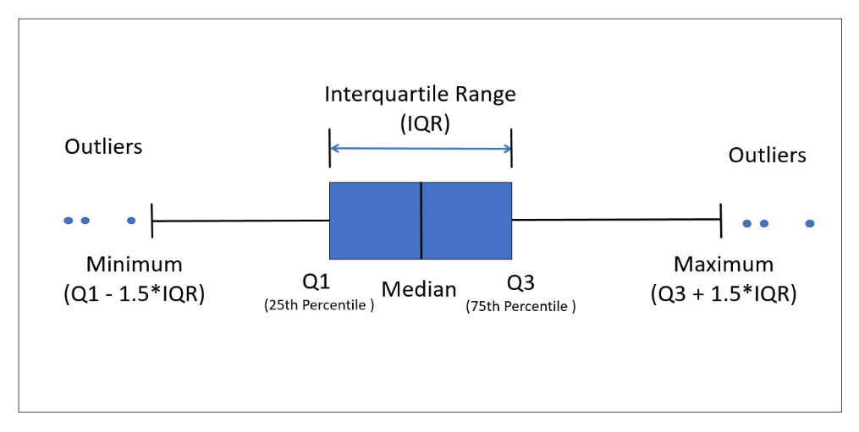
Point to Point Output shown in the PDF File.

Slide 5
THANK YOU

